Slide 1

CAPSTONE PROJECT
Digits Recognition Neural Network
Final Project
Presented By
Shubhapradaa T KA
711721244052
III Btech CSBS
KGiSL Institute of Technology
3/21/2024 Annual Review
1

Slide 2

PROJECT
Classify Handwritten digits using a simple neural network
3/21/2024 Annual Review
2

Slide 3



AGENDA
1. Problem Statement
2. Project Overview
3. End Users
4. Solution and Value Proposition
5. The Wow Factor in Your Solution
6. Modelling
7. Results
3
3/21/2024 Annual Review

Slide 4

PROBLEM STATEMENT
Introduce the challenge of handwritten digit recognition.
Highlight the importance of accurate digit classification in various applications, such as postal services, banking, and automation.
3/21/2024 Annual Review
4

Slide 5

PROJECT OVERVIEW
Provide an overview of the project's goal: to classify handwritten digits using neural networks.
Mention the utilization of the MNIST dataset, consisting of 60,000 training images and 10,000 testing images of handwritten digits.
3/21/2024 Annual Review
5

Slide 6

WHO ARE THE END USERS?
Identify potential end users of the solution, such as organizations requiring digit recognition for automated processes, developers working on image recognition applications, and researchers in the field of machine learning.
3/21/2024 Annual Review
6

Slide 7

SOLUTION AND ITS VALUE PROPOSITION
Present the solution: a neural network model for handwritten digit recognition.
Emphasize the value proposition, including increased efficiency, accuracy, and automation in digit classification tasks.
3/21/2024 Annual Review
7

Slide 8

THE WOW IN YOUR SOLUTION
Highlight unique aspects or features of the solution that differentiate it from traditional methods or other approaches.
Showcase any innovative techniques, optimizations, or performance enhancements incorporated into the model.
3/21/2024 Annual Review
8

Slide 9
MODELLING
Describe the architecture of the neural network model used, starting with a simple model with input and output layers, and then adding a hidden layer.
Explain key components such as activation functions, optimization algorithms, and training procedures.
3/21/2024 Annual Review
9

Slide 10
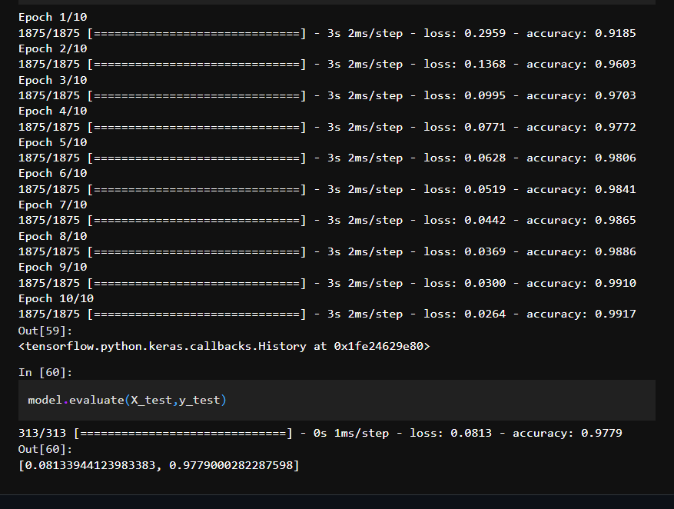
RESULTS
Demo Link
3/21/2024 Annual Review
10

